Slide 1
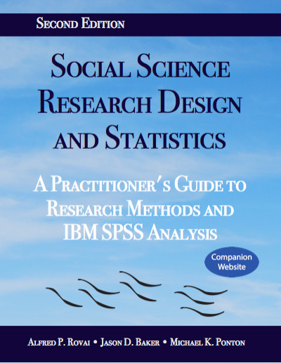
Social Science Research Design and Statistics, 2/e
Alfred P. Rovai, Jason D. Baker, and Michael K. Ponton
Evaluating Linearity
PowerPoint Prepared by
Alfred P. Rovai
IBM® SPSS® Screen Prints Courtesy of International Business Machines Corporation,
© International Business Machines Corporation.

Slide 2
Evaluating Linearity
The assumption of linearity is that there is an approximate straight line relationship between two continuous variables. It is a common assumption in many bivariate and multivariate tests, such as correlation and regression analysis, because solutions are based on the general linear model (GLM).
If a relationship is nonlinear, the statistics that assume it is linear will either underestimate the strength of the relationship or fail to detect the existence of a relationship.
Methods of evaluating linearity:
  Draw on theory or prior research.
  Use graphical methods, e.g., scatterplots. In regression analysis, nonlinearity is usually most evident in a plot of the observed versus predicted values or a plot of residuals versus predicted values, which are a part of SPSS regression output.
  Compare the linear correlation coefficient (Pearson r) to the nonlinear correlation coefficient (eta). A large difference suggests nonlinearity.

Slide 3
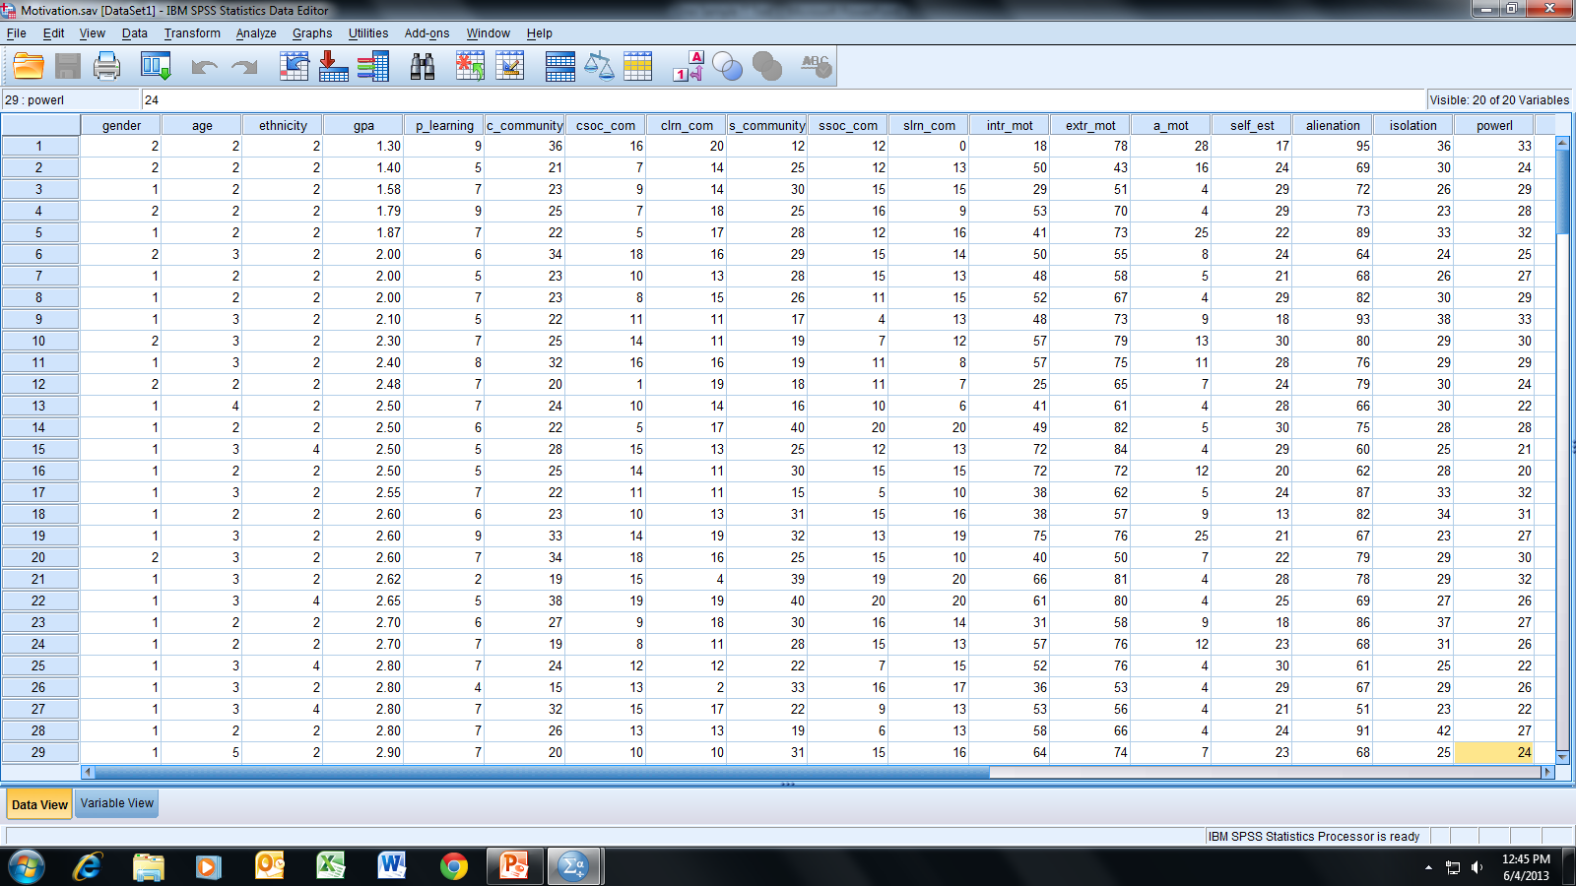
Open the dataset Motivation.sav.
File available at http://www.watertreepress.com/stats
TASK
Evaluate linearity for
Powerlessness and Normlessness.

Slide 4
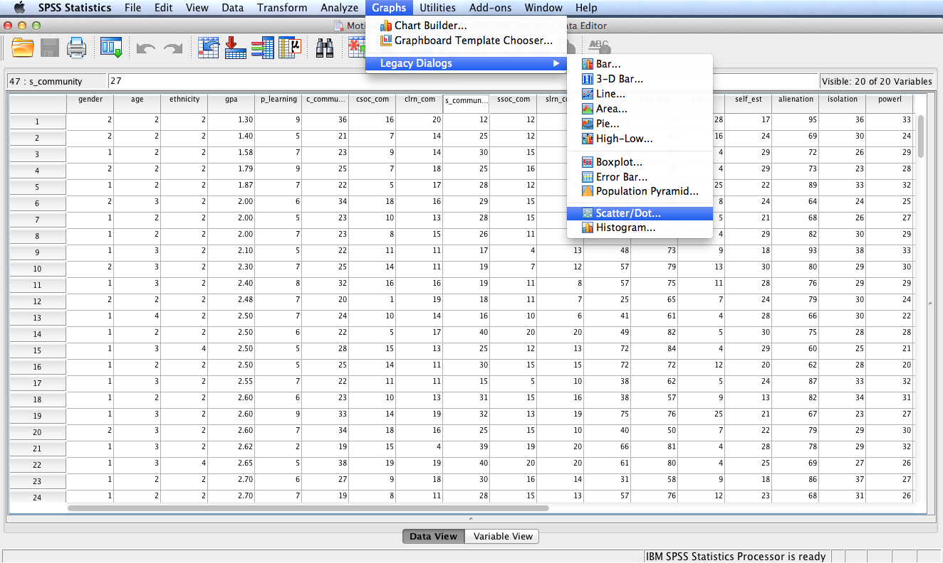
Follow the menu as indicated.

Slide 5
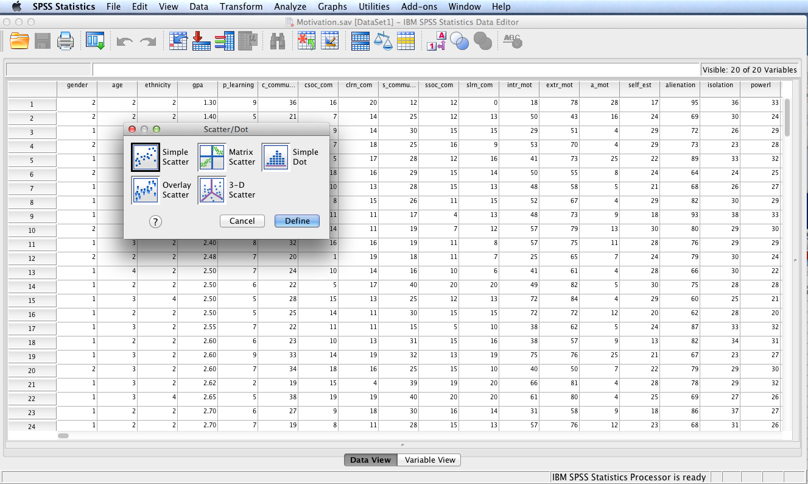
Click the Simple Scatter icon and then the Define button.

Slide 6
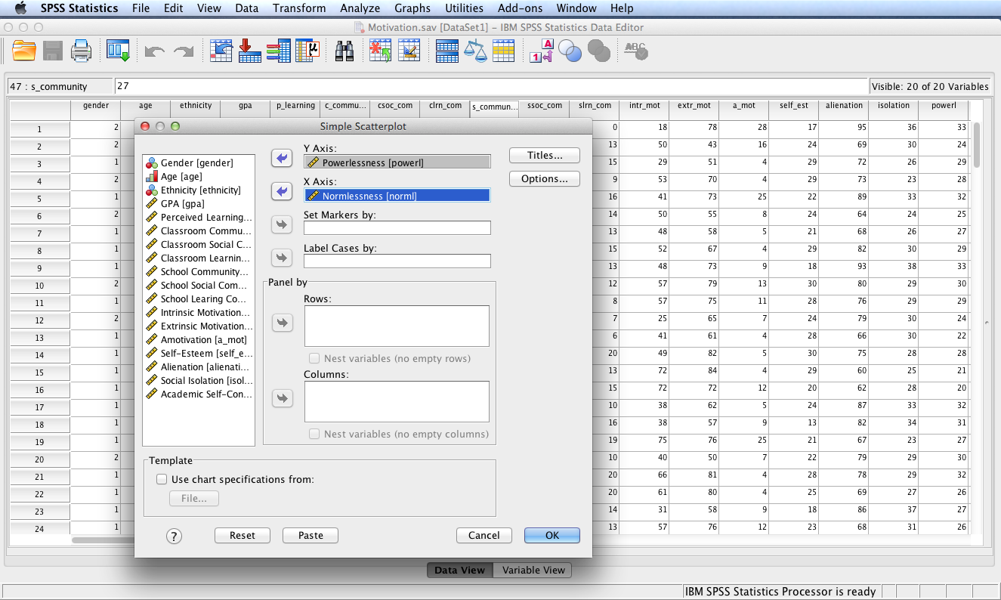
Move Powerlessness to the Y Axis: box and Normlessness to the X Axis: box. Click OK.

Slide 7
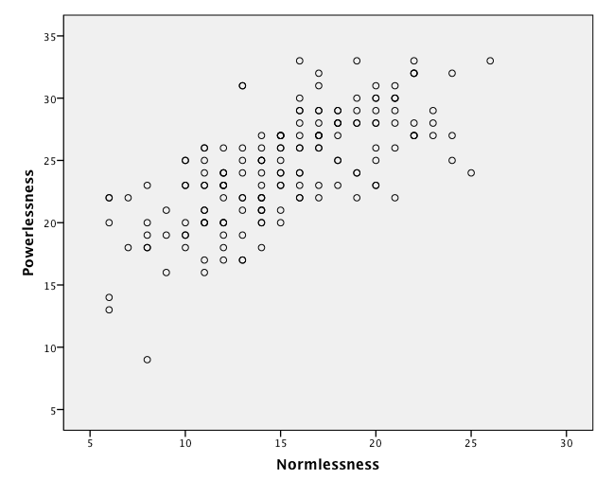
SPSS Output
An inspection of the scatterplot suggests linearity is tenable between powerlessness and normlessness since the dots appear to follow a straight line. There is no discernable bend in the pattern of dots that would suggest a curvilinear relationship.

Slide 8
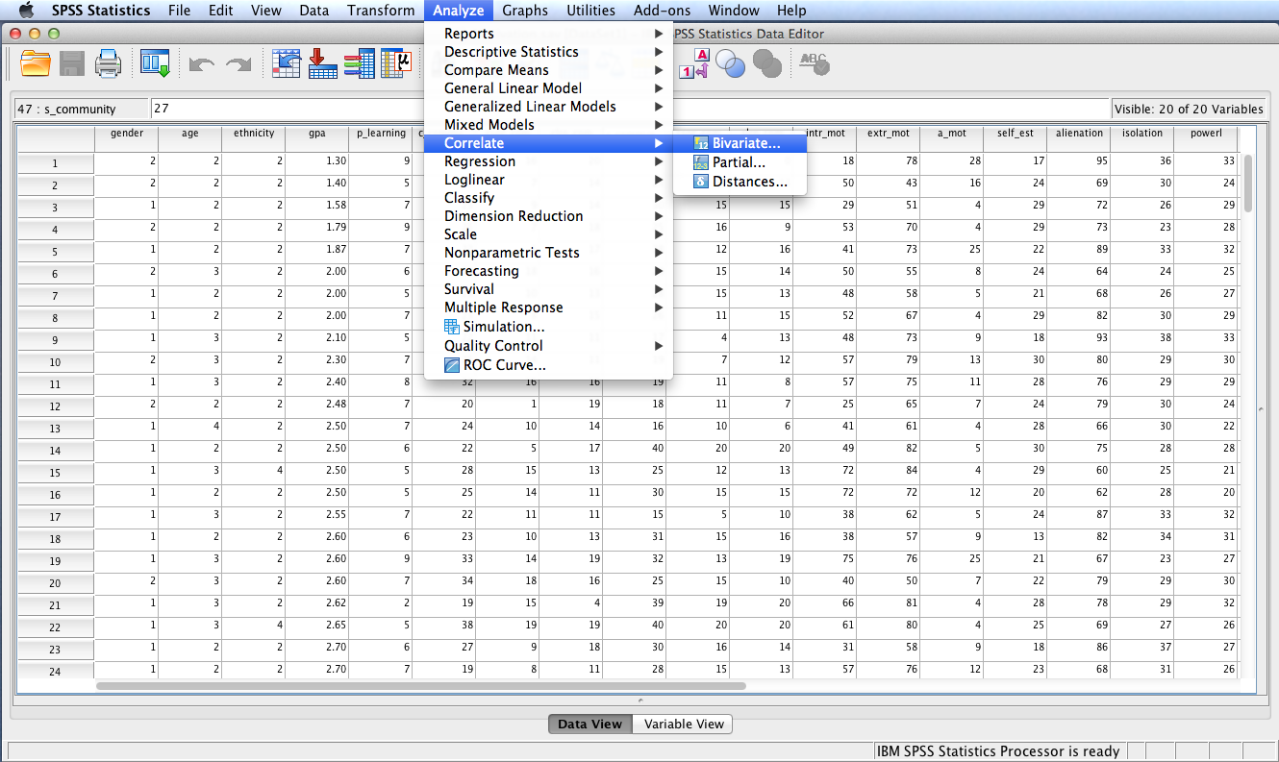
Follow the menu as indicated to calculate the linear (Pearson r) relationship between powerlessness and normlessness.

Slide 9
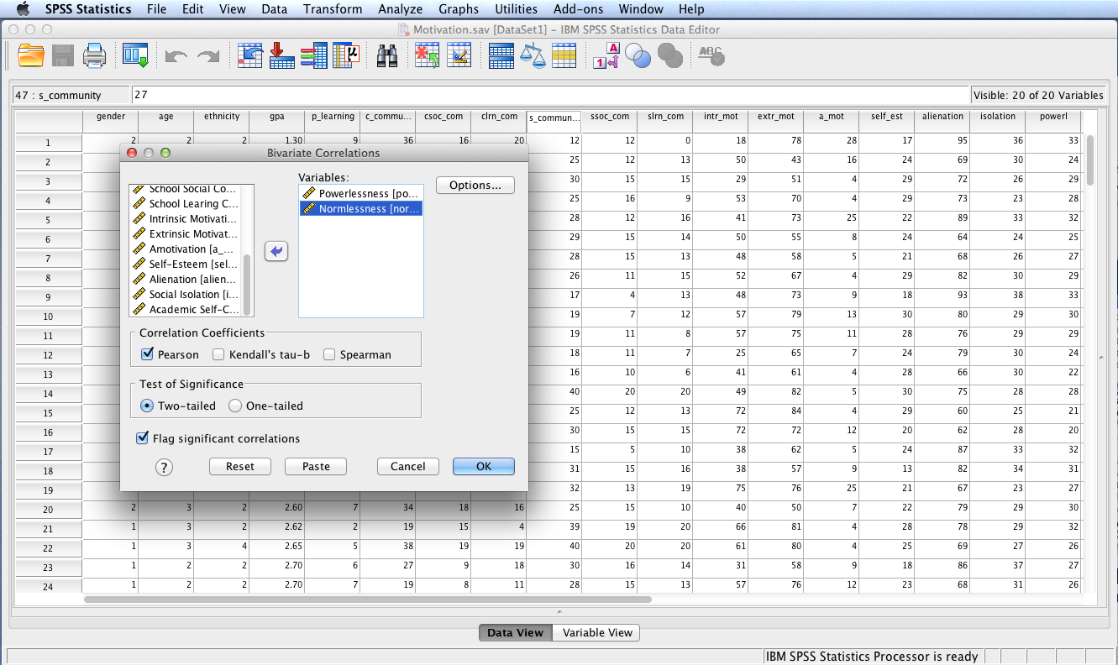
Move Powerlessness and Alienation to the Variables: box. Then click OK.

Slide 10
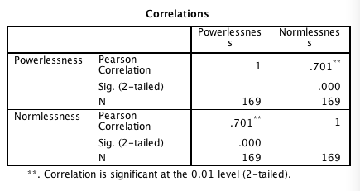
SPSS Output
SPSS output shows a significant linear relationship between powerlessness and normlessness, r(167) = .701, p < .001.

Slide 11
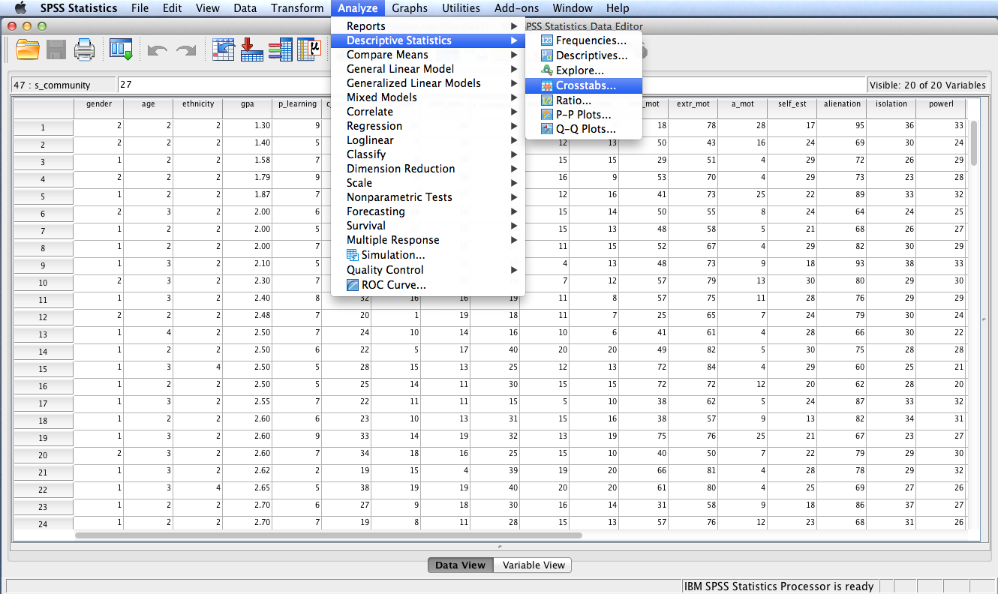
Follow the menu as indicated to calculate the nonlinear (eta) relationship between powerlessness and normlessness.

Slide 12
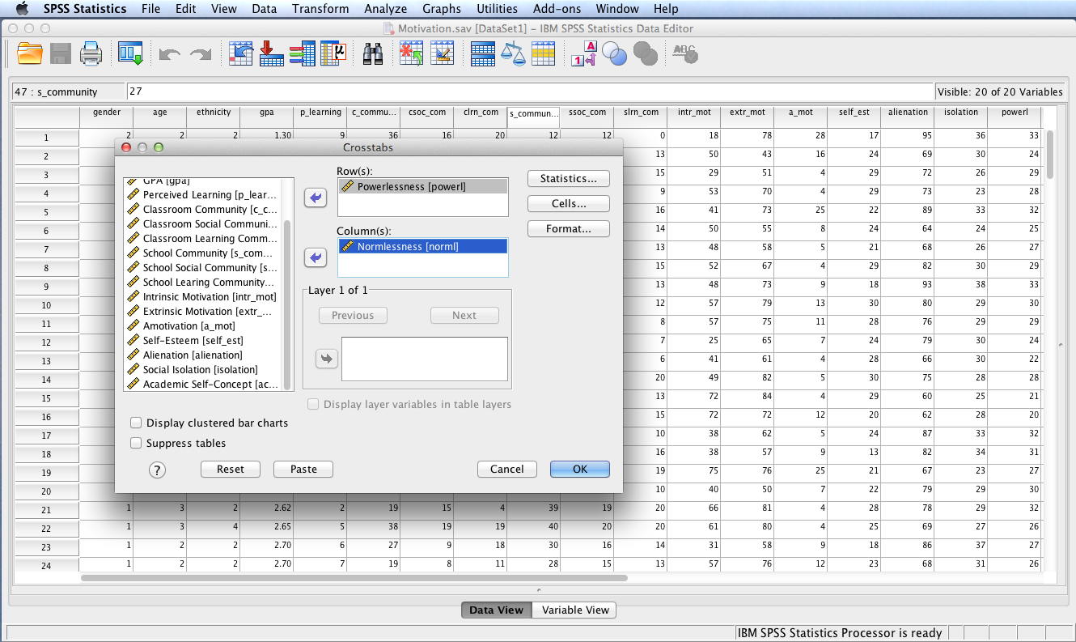
Move Powerlessnes to the Row(s): box and Normlessness to the Column(s): box, or vice versa. Click the Statistics button.

Slide 13
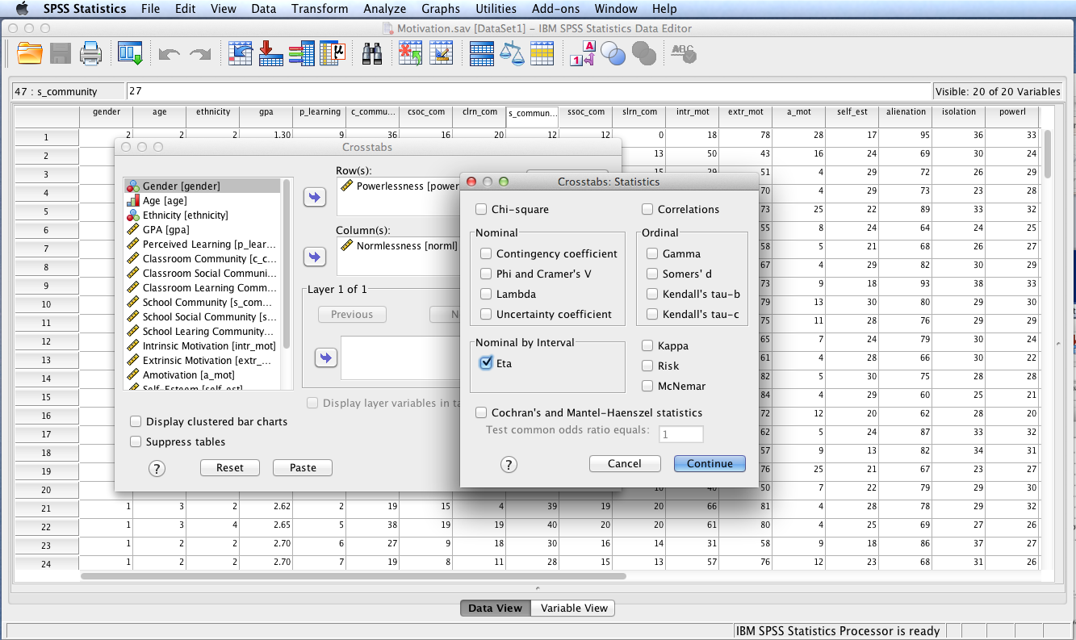
Check the Eta box and then click Continue and OK.

Slide 14
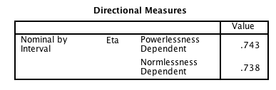
SPSS Output
SPSS output shows a significant total relationship (linear + curvilinear) between powerlessness and normlessness, η = .74. This relationship is similar to the linear only relationship, r = .70, providing additional support to the conclusion reached by inspecting the scatterplot that the relationship between powerlessness and normlessness is linear.

Slide 15
End of Presentation

